Slide 1
GYM Website
By Nilam Vaza

Slide 2
Introduction
Purpose of the Project:
Create an interactive and user-friendly website for a gym. Showcase essential gym services and facilities.

Slide 3
HTML - for structure
CSS - styling
JavaScript - interactivity
Technologies Used:

Slide 4
Features of the Website
Homepage: Eye-catching design with gym details and an introduction.
Facility : Display of facility of the Gym
Services Section: Display of gym services like personal training, group classes, etc.
Contact Form: Easy-to-use form for inquiries
Elements: Navigation bar, buttons and animations.

Slide 5
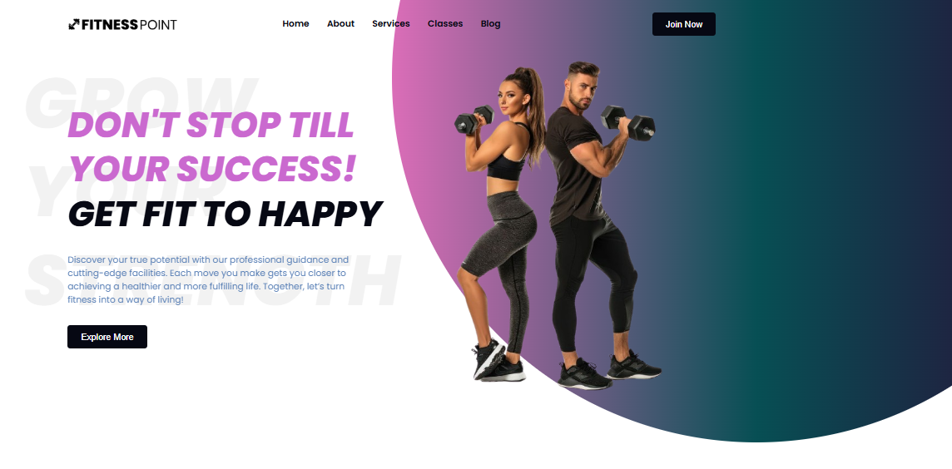
Design and Layout
Home Page

Slide 6

Design and Layout
About

Slide 7
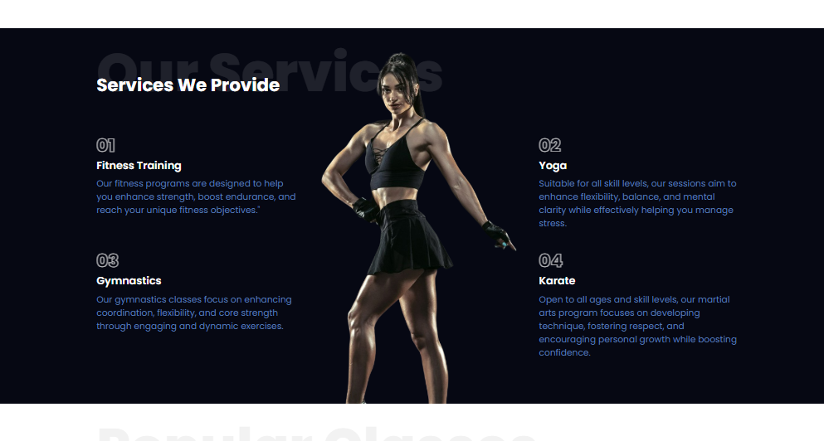
Design and Layout
Services

Slide 8
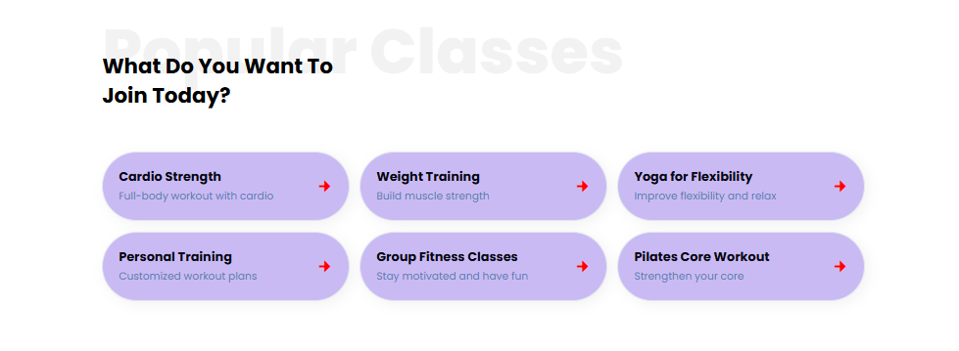
Design and Layout
Classes

Slide 9
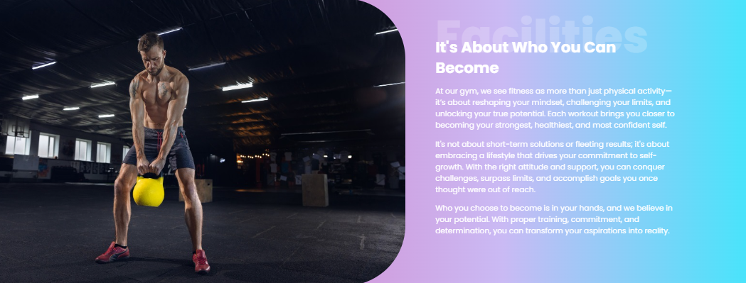
Design and Layout
Facility :

Slide 10

Design and Layout
Mentor :

Slide 11
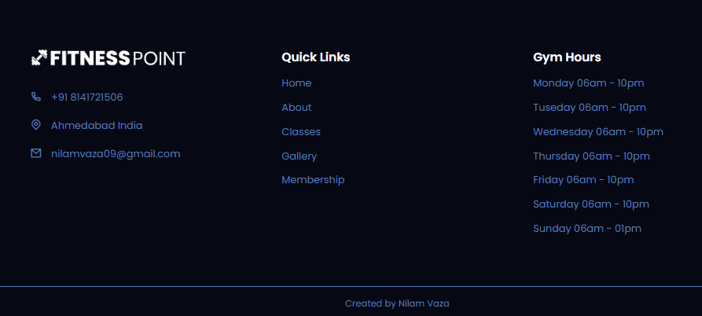
Design and Layout
Footer :

Slide 12
"Fitness at Your Fingertips": Our gym website aims to provide users with an engaging, user-friendly platform to explore fitness options, book sessions, and stay motivated.
CONCLUSION

Slide 13
Thank you

